Slide 1



Data Science Methods for Clean Energy Research (DSMCER) & Software Engineering for (SEMDS) Molecular Data Scientists
Knowledge and solutions for a changing world
Advancing data-intensive discovery in all fields
Be boundless
UW DIRECT
(Data Intensive Research Enabling Cutting-edge Tech)
https://uwdirect.github.io
Dave Beck (dacb)
eScience/Chemical Engineering
Evan Komp
Chemical Engineering
Notes:
Update from last year:
slight rearranging of DS problem statement, now: advancements that allow DS, problem of memory and time, broad statement regarding this class (we will show you methods to extract information from data, and operating in the constraints of computational power). Removed redundant slides with somewhat unrelatable big numbers
Added slide on intersection between physical sciences and DS as a motivator – it takes both skillsets to do this well
Slides on data management and visualization about the same, minor updates
Removed all but highest level ML content – not worth talking about overfitting and test sets yet. Just basic what is Supervised and unsupervised and an example of each
Added introduction to each toy dataset that will be used for the whole class

Slide 2
What is this class about?
Overview of Data Science methods
Basics of statistics
Tool selection
Best practices
Not about designing new algorithms
Group project using these methods
Provide you with computational tools and a software mindset to tackle science problems

Slide 3
Course website & setup
Equipment / work platforms
Laptops: use them !
Canvas: use it!
Software: install it!
Class website: https://uwdirect.github.io

Slide 4
Code of Conduct
Please read and make sure to respect the code of conduct
https://uwdirect.github.io/code_of_conduct.html
If you find cases where the code of conduct is not being respected, let us know!
If you do not respect the code of conduct, we may refer to the university for action.

Slide 5
Two quarters of courses in one!
Two quarter courses make up training
CHEME 546: Software Engineering for Molecular Data Scientists (SEMDS)
One quarter (10 weeks)
CHEME 545: Data Science Methods for Chemical Engineering Research (DSMCER)
One quarter (10 weeks)
UW runs these concurrently
SEMDS
DSMCER
Week 1 |  | Week 2 |  | Week 3 |  | Week 4 |  | Week 5 |  | Week 6 |  | Week 7 |  | Week 8 |  | Week 9 |  | Week 10
AM
PM

Slide 6
Two quarters of courses in one!
Two quarter courses make up training
CHEME 546: Software Engineering for Molecular Data Scientists (SEMDS)
One quarter (10 weeks)
CHEME 545: Data Science Methods for Chemical Engineering Research (DSMCER)
One quarter (10 weeks)
We run these concurrently
SEMDS
DSMCER
Week 1 |  | Week 2 |  | Week 3 |  | Week 4 |  | Week 5 |  | Week 6 |  | Week 7 |  | Week 8 |  | Week 9 |  | Week 10
AM
PM

Slide 7

About Evan
Background – ChE (BS), PhD student in ChemE
Research – Conducting and Teaching at the intersection of Machine Learning and Chemical/Biological sciences, Reaction Kinetics, Protein Stability
Office: BNS 236
Email: evankomp+dsmcer@uw.edu
Office Hours: M 11:00 @ BNS 241

Slide 8
About Dave Beck
Background – Computer science, biology, chemistry (BS); Medicinal Chemistry (PhD); BioE (post-doc)
Research – Molecular data science with applications in energy, environment and health. Scientific software engineering for reproducibility.
Molecular mechanics
*omics
ML in molecular settings
Office: Zoom and Slack
Email: dacb@uw.edu

Slide 9
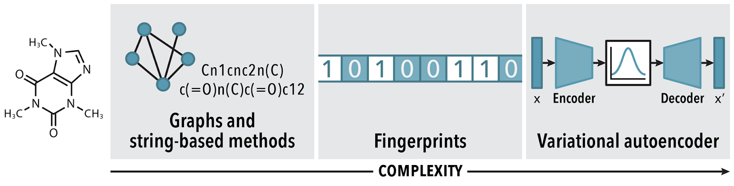
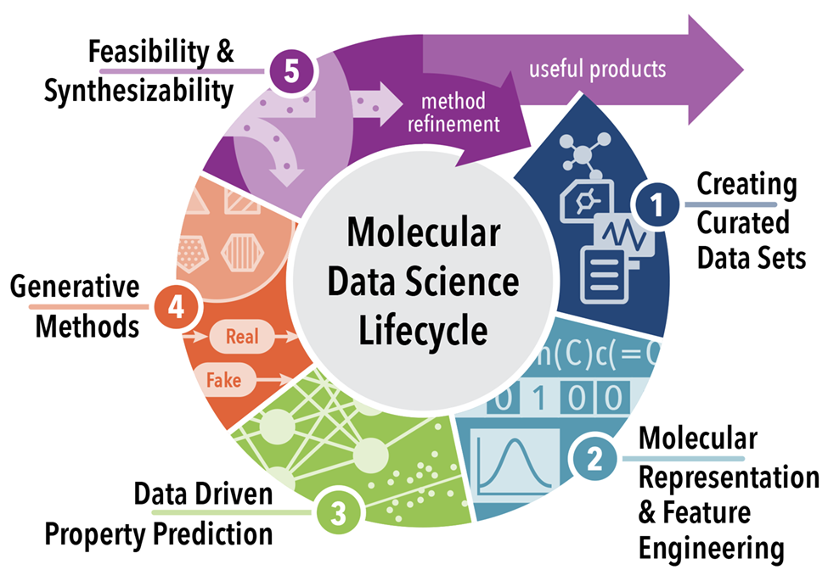
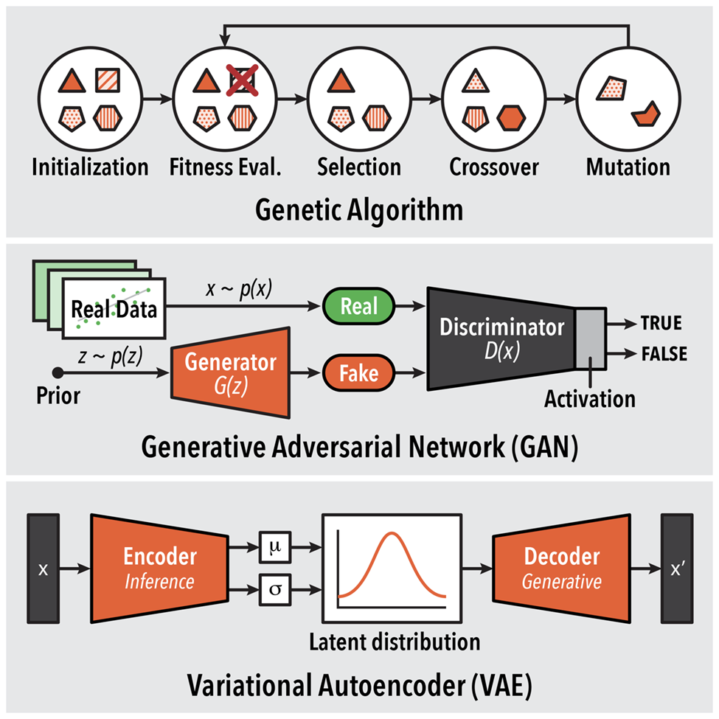
Molecular Data Science
Combining (a) diverse data sources and unique (b) molecular representations and (c) generative models to design new molecules.
(b)
(a)
(c)
[1] Ashraf, Joshi, Beck, Pfaendtner. Ann. Rev. Bio. Chem. Eng. https://doi.org/10.1146/annurev-chembioeng-101220-102232

Slide 10


Teaching Assistants
Orion
Nels
Email: odollar@uw.edu
Email: nlsschim@uw.edu

Slide 11
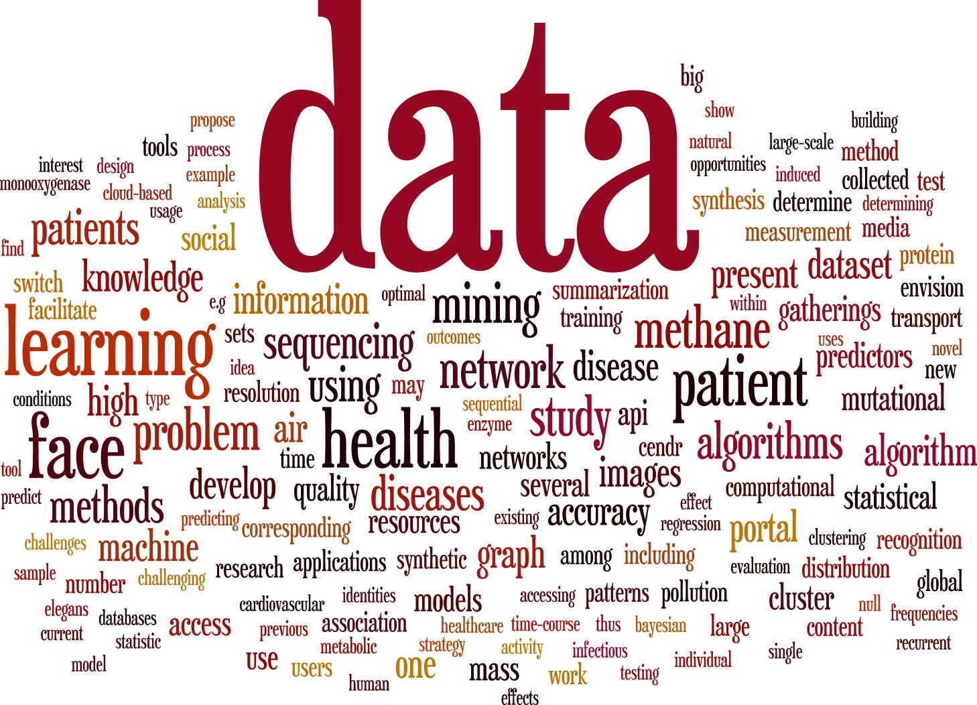
Data + science?
Science, Art & Engineering
Physical Sciences: Physics, Chemistry, Biology, Molecular science
Engineering: Environment, Materials, Civil, Electrical
Social Sciences: Psychology, Economics, Sociology, Public Policy

Slide 12
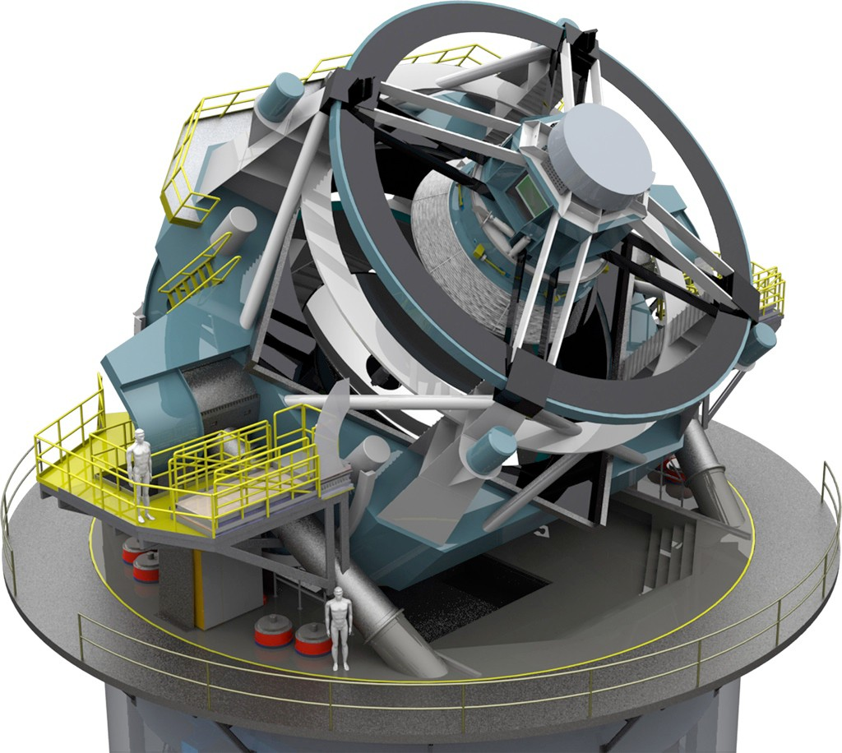
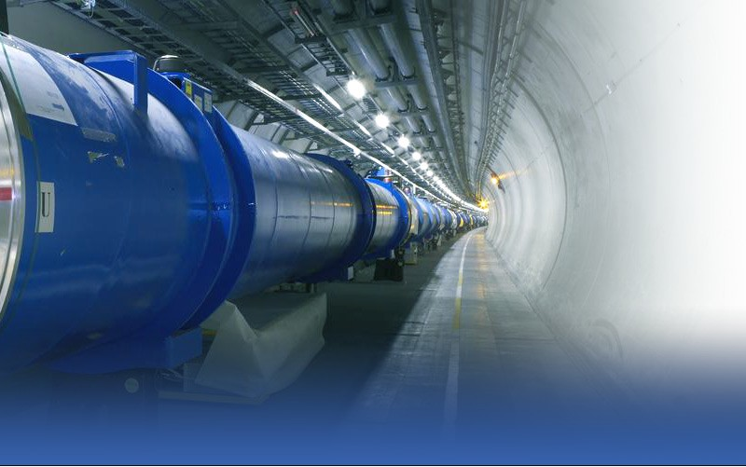
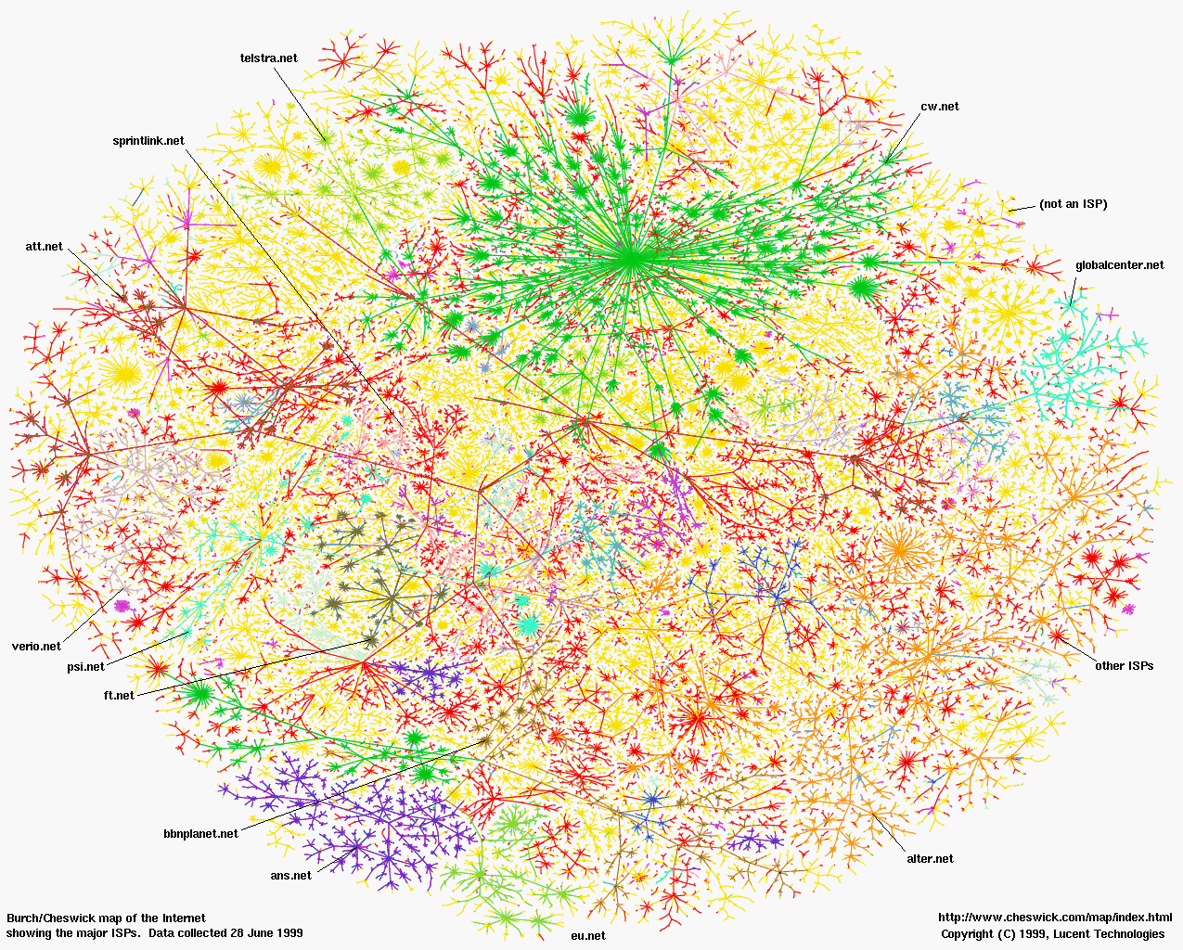
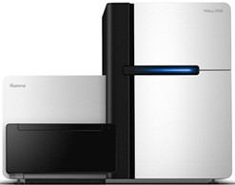
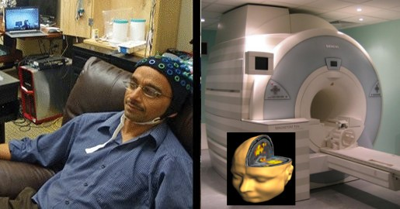
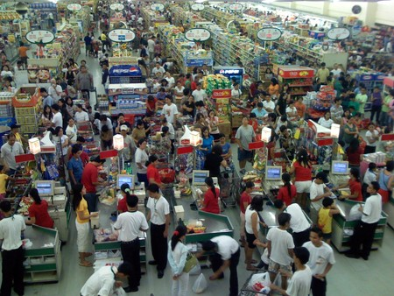
OMG, so much data!
All fields of science: “data poor” → “data rich”
Astronomy: LSST
Physics: LHC
Sociology: Social networks
Biology: Sequencing
Neuroscience: EEG, fMRI
Economics: POS terminals

Slide 13
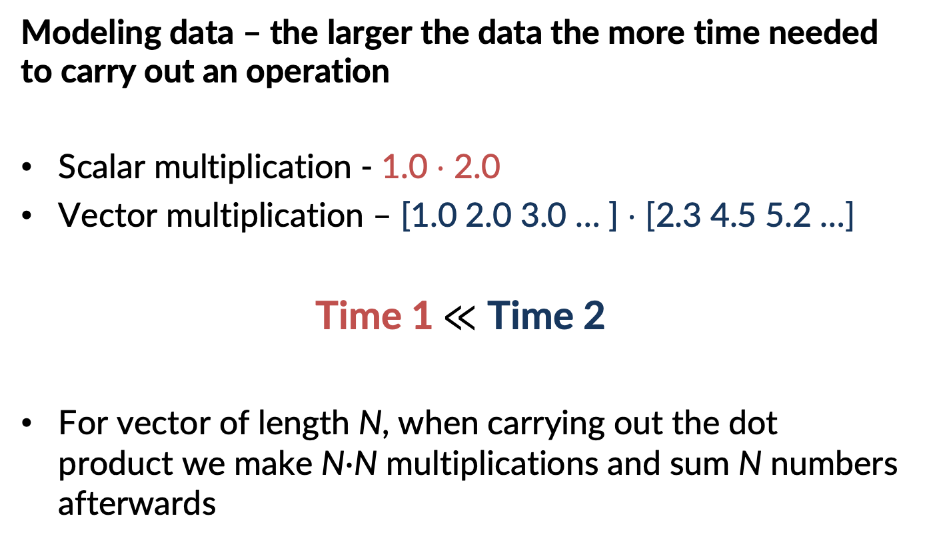
Need time & energy to compute
Modeling data – the larger the data the more time needed to carry out an operation
Scalar multiplication - 1.0 $⋅$ 2.0
Vector multiplication – [1.0 2.0 3.0 … ] $⋅$ [2.3 4.5 5.2 …]
Time 1$≪$ Time 2
For vector of length N, when carrying out the dot product we make N$∙$N multiplications and sum N numbers afterwards

Slide 14
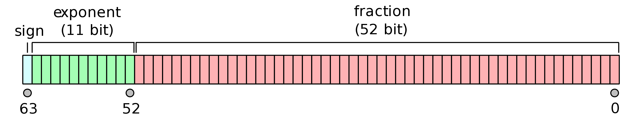
Need memory to store data
One double precision number (16 significant figures) needs 64 bits – 8 bytes
3.14159265358979311599796346844185161590576171875
One color image from your phone is ~24 million numbers
-> A dataset of images can be many terabytes in size, even modern computers cannot work on the whole dataset simultaneously

Slide 15
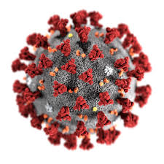

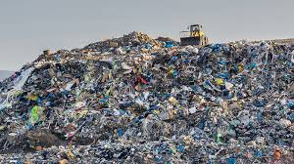
This cost can be prohibitive
Extracting properties from/using large dataset is computationally demanding: high memory cost & time demand
We need answers now for important problems
Drug/antiviral design
Global warming - ecological forecasting
Real-time sensing, learning, decision-making
Detecting hazardous weather
Ref: The National Science Foundation's (NSF) Harnessing the Data Revolution (HDR) Big Idea

Slide 16

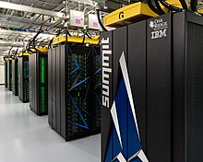
Computers then and now
1943
2018
ENIAC - Electronic Numerical Integrator and Computer
High-speed memory - 20 words (equivalent to about 80 bytes)
simple calculations involving 20 numbers of ten decimal digits
add and subtract 5000 times per second
SUMMIT - 2nd fastest in the world
Non-volatile memory per node 1600 gigabytes GB
mathematical calculations at the rate of 200 quadrillion per second, or 200 petaflops
https://en.wikipedia.org/wiki/Computer#First_computing_device
https://www.olcf.ornl.gov/summit/
Notes:
RAM 1963
The basic machine cycle was 200 microseconds (20 cycles of the 100 kHz clock in the cycling unit), or 5,000 cycles per second for operations on the 10-digit numbers. In one of these cycles, ENIAC could write a number to a register, read a number from a register, or add/subtract two numbers.
The ENIAC^{[37]} (Electronic Numerical Integrator and Computer) was the first electronic programmable computer built in the U.S. Although the ENIAC was similar to the Colossus, it was much faster, more flexible, and it was Turing-complete. Like the Colossus, a "program" on the ENIAC was defined by the states of its patch cables and switches, a far cry from the stored program electronic machines that came later. Once a program was written, it had to be mechanically set into the machine with manual resetting of plugs and switches. The programmers of the ENIAC were six women, often known collectively as the "ENIAC girls".^{[38][39]}
It combined the high speed of electronics with the ability to be programmed for many complex problems. It could add or subtract 5000 times a second, a thousand times faster than any other machine. It also had modules to multiply, divide, and square root. High speed memory was limited to 20 words (about 80 bytes). Built under the direction of John Mauchly and J. Presper Eckert at the University of Pennsylvania, ENIAC's development and construction lasted from 1943 to full operation at the end of 1945. The machine was huge, weighing 30 tons, using 200 kilowatts of electric power and contained over 18,000 vacuum tubes, 1,500 relays, and hundreds of thousands of resistors, capacitors, and inductors.^{[40]}

Slide 17


Big Data + Big Compute =
Big Utility...
We will explore in this course:
what kind of data is out there, how can we operate on it, and what information we can extract
+ Big responsibility
And how to consider:
Code
Data
Useful information
Memory
Computational power
Energy and carbon

Slide 18
Your skillset is critical!
Code
Data
Useful information
Design solution
Identify desired product
Process data
Draw conclusions or utilize tool
Collect data and formulate assumptions
Incorporate domain knowledge
Interpret results
Chemical scientists can do
Data scientists can do
You will be able to do!
Software engineers make sure all of this can be used by others!

Slide 19
New paradigm of data-intensive discovery and innovation
Deep domain knowledge
Data Science
Data management
Databases, scalable data handling, data curation
Statistics
Visualization
Machine learning
Supervised & unsupervised
Utility cost tradeoff
Software engineering

Slide 20


Data management
You’ve got lots of data, how do you manage it?
Not about lab notebooks anymore!
Databases
Structure and store large, heterogeneous data
Slice, subset, and retrieve it efficiently
Track provenance and metadata of your data
Relational databases
Structured Query Language (SQL)
Scalable data processing systems

Slide 21
New paradigm of data-intensive discovery and innovation
Deep domain knowledge
Data Science
Data management
Databases, scalable data handling, data curation
Statistics
Visualization
Machine learning
Supervised & unsupervised
Utility cost tradeoff
Software engineering

Slide 22
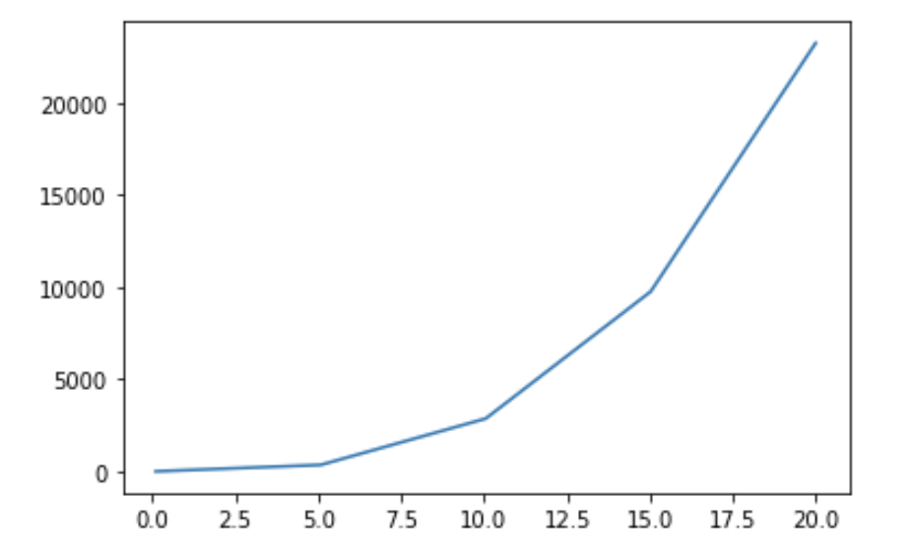
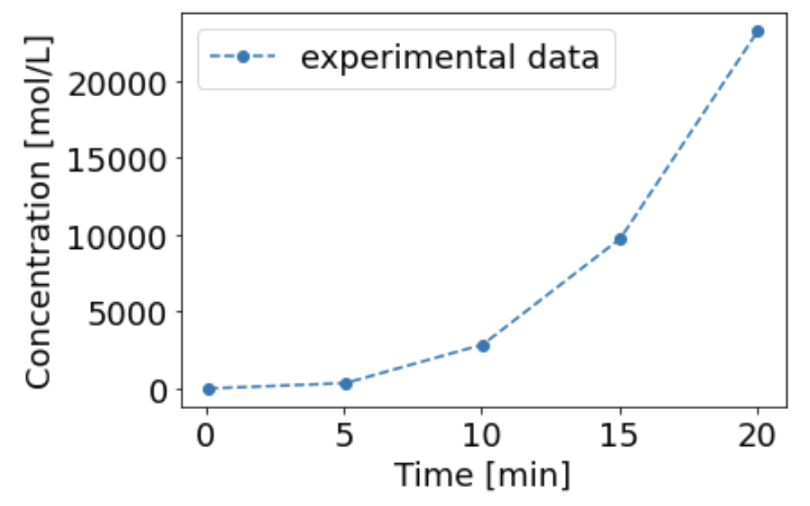
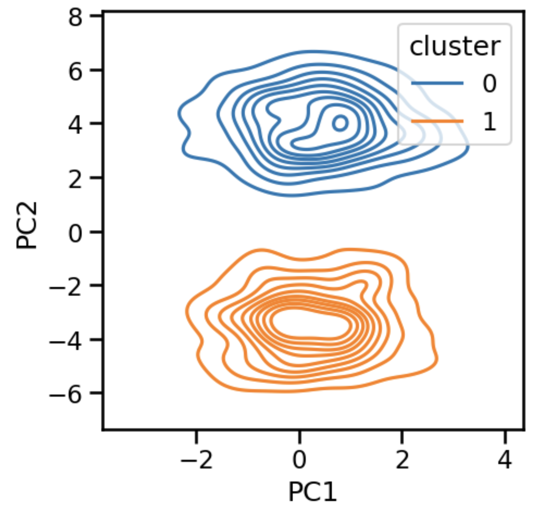
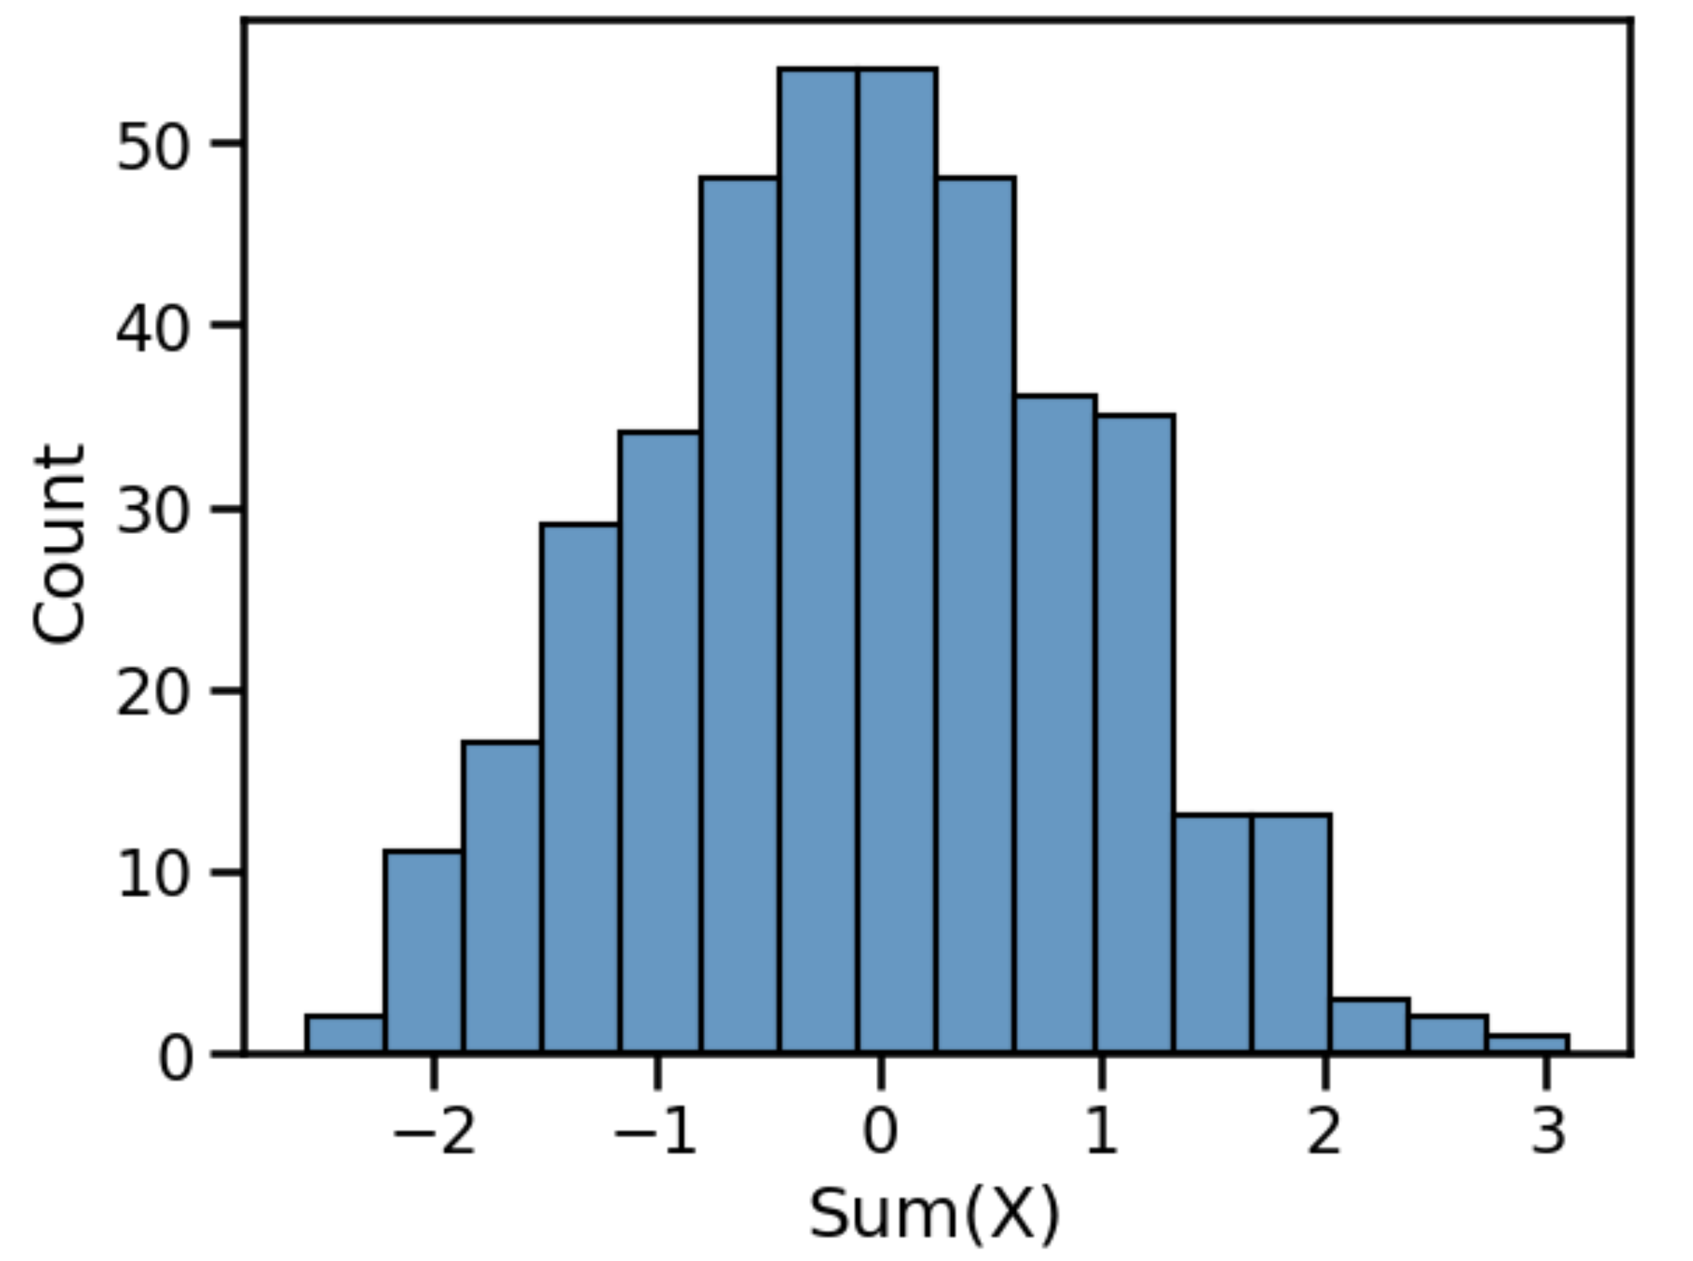
Visualization
How can visually display data in a useful way?
Effectiveness
Expressiveness

Slide 23
New paradigm of data-intensive discovery and innovation
Deep domain knowledge
Data Science
Data management
Databases, scalable data handling, data curation
Statistics
Visualization
Machine learning
Supervised & unsupervised
Utility cost tradeoff
Software engineering

Slide 24

Machine learning
Sign on Bonus!
www.slideshare.net/awahid

Slide 25
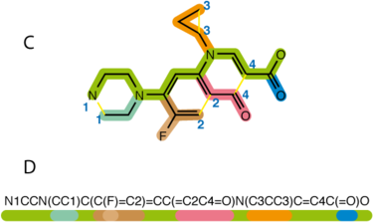
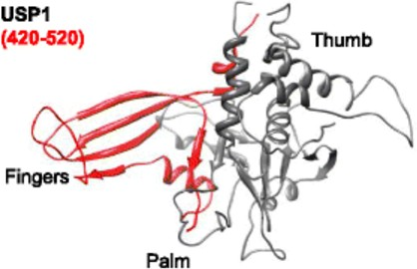
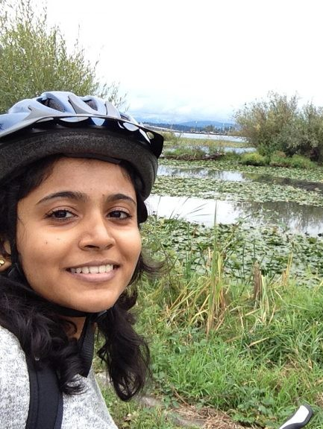

Supervised ML helps us accelerate
Supervised: Predict a measured, expensive label using low cost features
Example: develop structure-activity-relationship eg. binding affinity to cancer target
Database of 400,000 drug like molecules
Experimental inhibition activities against cancer drug target
Build a model that relates molecular features to a numerical measure of inhibition, dissociation constant (Kd)
For a new small molecule, predict the Kd?^{1,2}
+
=?
https://github.com/BeckResearchLab/USP-inhibition
https://github.com/BeckResearchLab/small-molecule-design-toolkit
Pearl Philip & Rahul Avadhoot

Slide 26
SML requires labeled data
Supervised
Features or predictors
Outcome
Molecule | Diffusion (nm/s) | Molecular Weight | C=C bonds | H-bond donors | H-bond acceptors | Kd (fM)
1 | 8 | 66 | 1 | 0 | 0 | 1
2 | 5 | 44 | 2 | 1 | 0 | 12
3 | 6 | 95 | 0 | 2 | 0 | 14
4 | 7 | 63 | 4 | 0 | 0 | 1
5 | 8 | 65 | 1 | 0 | 1 | 4
6 | 3 | 91 | 1 | 1 | 1 | 3
7 | 6 | 94 | 2 | 0 | 1 | 2
8 | 3 | 96 | 1 | 2 | 1 | 2
9 | 7 | 57 | 3 | 1 | 1 | 6
10 | 6 | 121 | 1 | 0 | 0 | 8

Slide 27

SML requires labeled data
Supervised
Features or predictors
Outcome
Molecule | Diffusion (nm/s) | Molecular Weight | C=C bonds | H-bond donors | H-bond acceptors | Kd (fM)
1 | 8 | 66 | 1 | 0 | 0 | 1
2 | 5 | 44 | 2 | 1 | 0 | 12
3 | 6 | 95 | 0 | 2 | 0 | 14
4 | 7 | 63 | 4 | 0 | 0 | 1
5 | 8 | 65 | 1 | 0 | 1 | 4
6 | 3 | 91 | 1 | 1 | 1 | 3
7 | 6 | 94 | 2 | 0 | 1 | 2
8 | 3 | 96 | 1 | 2 | 1 | 2
9 | 7 | 57 | 3 | 1 | 1 | 6
10 | 6 | 121 | 1 | 0 | 0 | ???????

Slide 28
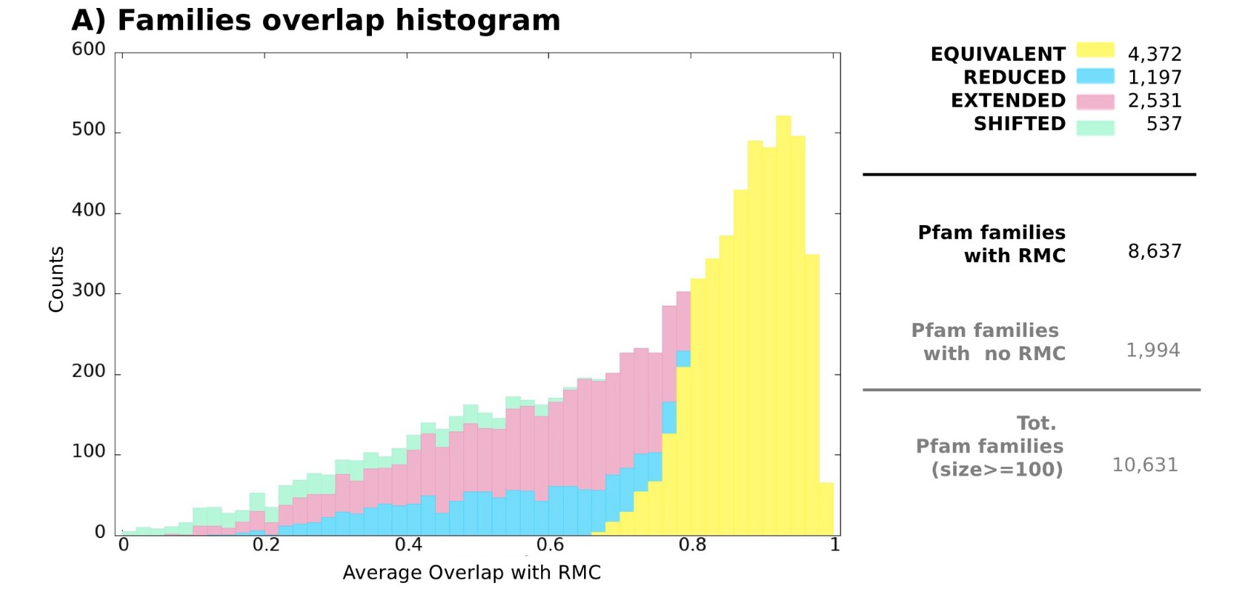
Unsupervised ML can help us interpret
Supervised: Intuit patterns in data to increase information or utility
Example: cluster protein alignments into families that conduct similar functions
…ARLKAKFPJOAAE…
Database of thousands of protein sequences and alignments to other proteins
Build a model that groups together protein sequences by evolutionary similarity
Explored groups that have not been tested before or guess the family of a new protein
…JOSAUAKFAJOAT…
…UAKFPJTAAELCQ…
…OSAGHQSATLA…
…
Russo, E. T.; Barone, F.; Bateman, A.; Cozzini, S.; Punta, M.; Laio, A. DPCfam: Unsupervised Protein Family Classification by Density Peak Clustering of Large Sequence Datasets. PLOS Computational Biology 2022, 18 (10), e1010610. https://doi.org/10.1371/journal.pcbi.1010610.

Slide 29
USML does not need labels
Unsupervised
Features
Molecule | Diffusion (nm/s) | Molecular Weight | C=C bonds | H-bond donors | H-bond acceptors
1 | 8 | 66 | 1 | 0 | 0
2 | 5 | 44 | 2 | 1 | 0
3 | 6 | 95 | 0 | 2 | 0
4 | 7 | 63 | 4 | 0 | 0
5 | 8 | 65 | 1 | 0 | 1
6 | 3 | 91 | 1 | 1 | 1
7 | 6 | 94 | 2 | 0 | 1
8 | 3 | 96 | 1 | 2 | 1
9 | 7 | 57 | 3 | 1 | 1
Mapping
?
?
?
?
?
?
?
?
?

Slide 30
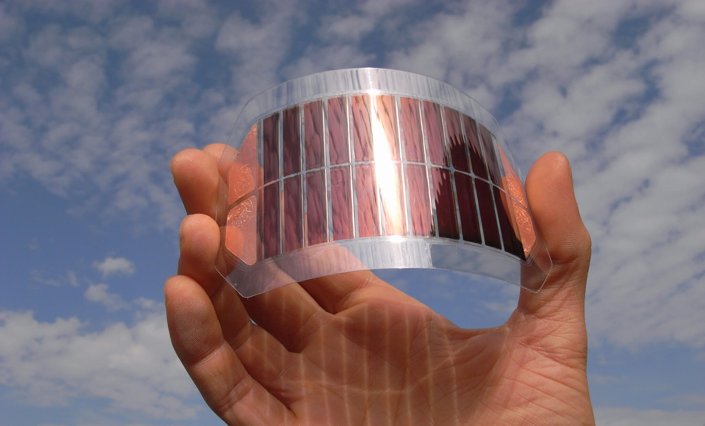
Dataset 1: HCEPDB
Source: Harvard Clean Energy Project – DOI 10.1021/jz200866s
Code
Data
Useful information
Data Description
2.3mil photovoltaic materials
Each has a chemical identity
Experimental measurements:
Open circuit voltage
Energy gap
Etc.
Synthesizing them is expensive
Interesting tasks
Can we predict solar cell capability without having to synthesize a new material?
How do the measurements taken correlate to each other?
Are there types of materials we should explore?
https://www.ise.fraunhofer.de/en/business-areas/photovoltaics/perovskite-and-organic-photovoltaics/organic-solar-cells-and-modules.html

Slide 31
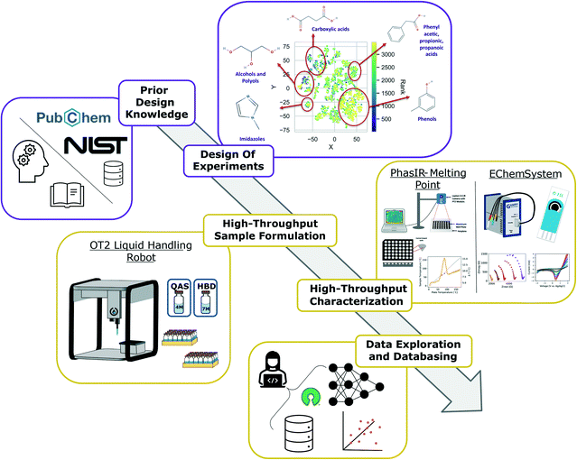
Dataset 2: High Throughput DES
Source: Pozzo Lab (Politi), UW ChemE - DOI 10.1039/D2ME00050D
Code
Data
Useful information
Data Description
Data for mixtures of 5 quaternary ammonium salts and 10 hydrogen bond donors
Experimental measurements for each:
Liquid at room temp
Electrolytes potentials
Interesting tasks
Can we interpolate the concentration a mixture will be solid?
Can we predict electrolyte potentials for new mixtures?
Can we suggest new mixtures to try to learn more?

Slide 32
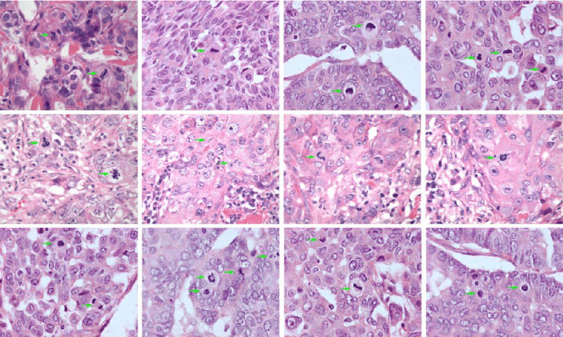
Dataset 3: Breast Cancer Cells
Source: Mittal Lab, Chemical Engineering
Code
Data
Useful information
Data Description
An H&E stained image of breast tissue
11 Infra red fields for each pixel in the image
Interesting tasks
Can we identify different cell types?
Can we diagnose cancerous regions?
Can we identify spatial patterns?

Slide 33
New paradigm of data-intensive discovery and innovation
Deep domain knowledge
Data Science
Data management
Databases, scalable data handling, data curation
Statistics
Visualization
Machine learning
Supervised & unsupervised
Utility cost tradeoff
Software engineering

Slide 34
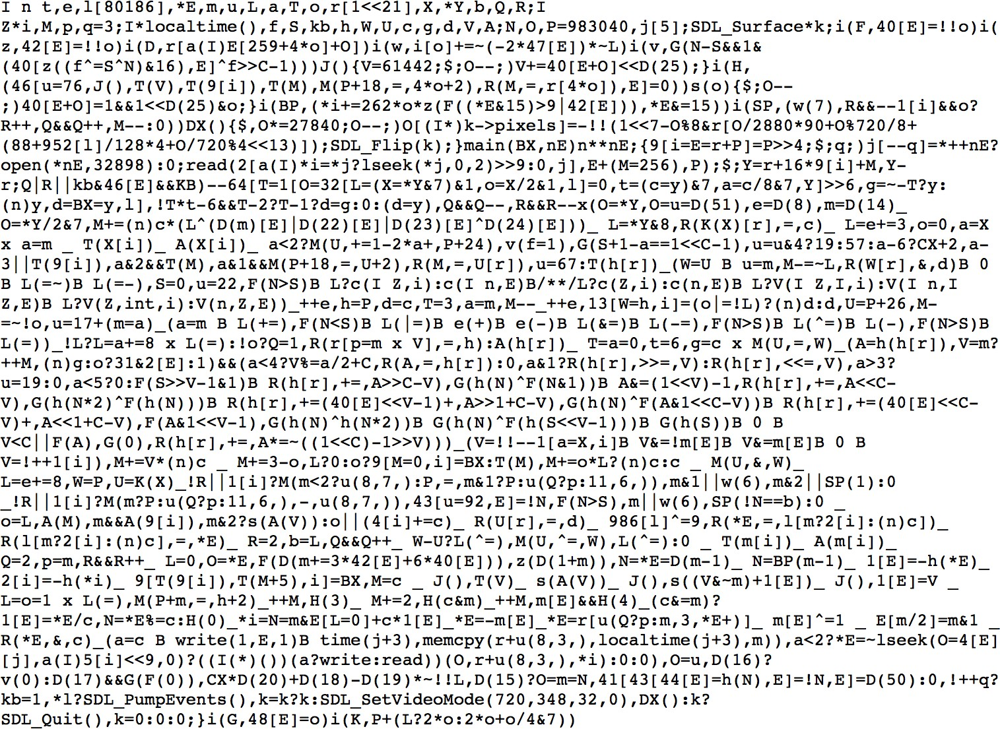
Software engineering
Your code should not look like this:

Slide 35
Software engineering
Scientific and engineering software tools are first class research products!
Programming is not software engineering
This is what CHEME/CHEM/MSE 546 is about!

Slide 36


We are all in this for your learning!
Notice the classroom?
Let’s make these lectures conversations
Ask questions or interrupt at any time
Periodic exercises and polls – discuss with your group
One person per exercise called to share what their group did

Slide 37
Meet each other!
The best way to learn is from each other!
Introduce yourselves (1st names and departments)
Go around the table, come to a consensus
What is Data Science?
What/who is a data scientist?
Why is Data Science a thing all of a sudden?
Why does Data Science matter, broadly, in my field of [insert]?
Why does Data Science matter, specifically, in my sub-discipline of [insert]?

Slide 38
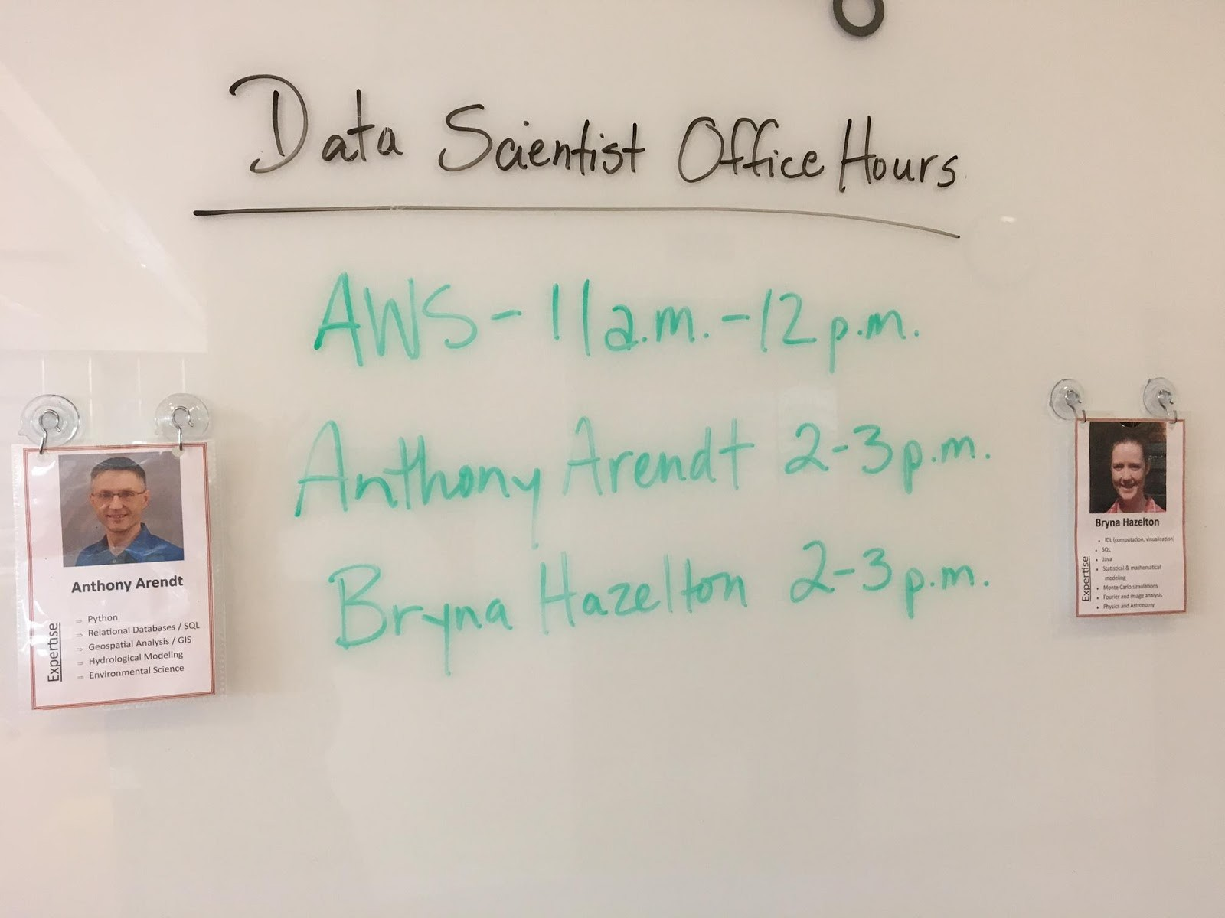

eScience to the rescue!
Data Scientist Office Hours
Get help with your data science questions
Data management
Machine learning
Statistics
Visualization
Software engineering

Slide 39
Questions?

